Slide 1
EspoCRM
Lecturer: Ngo Huy Bien
Software Engineering Department
Faculty of Information Technology
VNUHCM - University of Science
Ho Chi Minh City, Vietnam
nhbien@fit.hcmus.edu.vn

Slide 2

Objectives
To learn EspoCRM by yourself.

Slide 3

Contents

Slide 4

References

Slide 5


We Need a Problem First!

Slide 6
Example Needs
Replace Salesforce Cases by a cheaper solution.
Install and configure EspoCRM instance.

Slide 7


Slide 8
1. Find Appropriate Documentation
https://docs.espocrm.com/administration/installation/
https://docs.espocrm.com/administration/nginx-server-configuration/

Slide 9
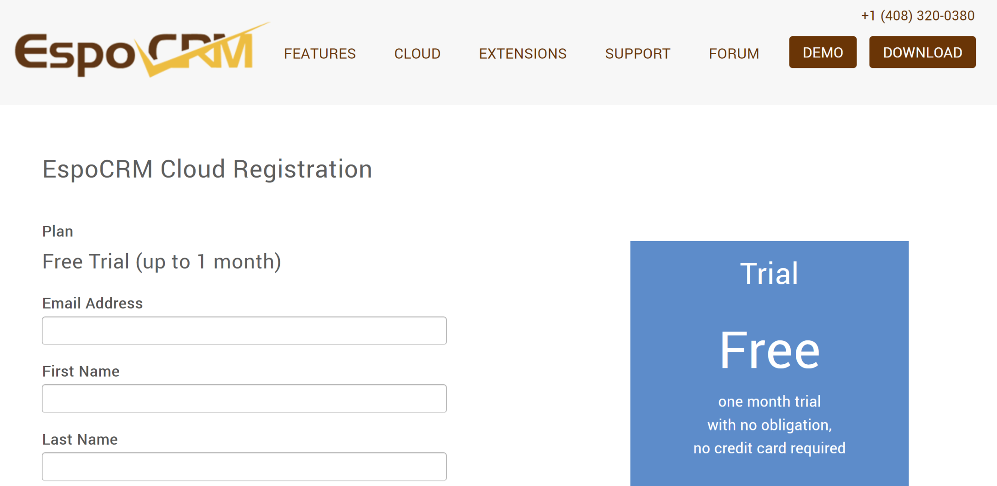
2. Try EspoCRM Cloud
https://www.espocrm.com/cloud-registration/

Slide 10
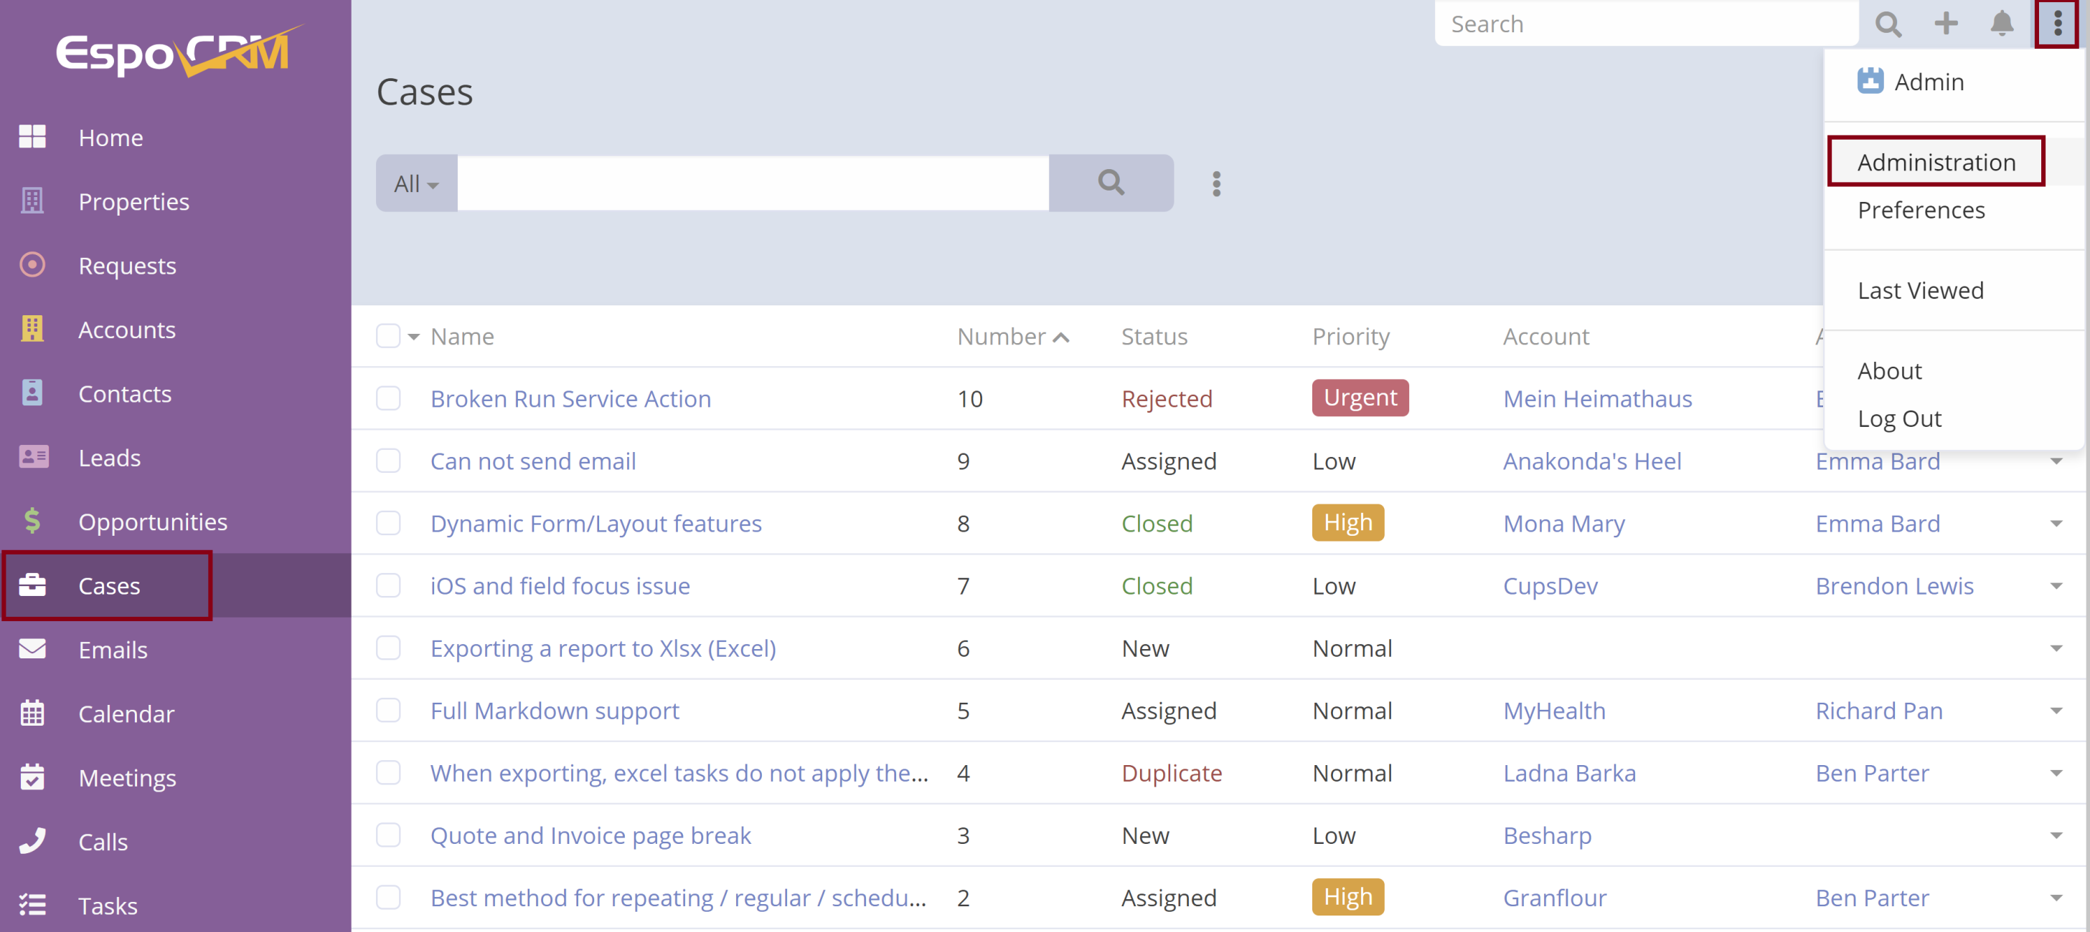
2. Try EspoCRM Case Management

Slide 12
1. Install EspoCRM
Use default option first.

Slide 13
2. Try Features
https://docs.espocrm.com/user-guide/stream/
Stream in EspoCRM is a feed where you can see updates and new additions for records you follow.
By default the following entity types have the stream: Accounts, Contacts, Leads, Opportunities, Cases, Tasks.
Administrators can enable or disable stream for a certain entity type in Entity Manager.
Record Stream. The Stream panel is available on the record detail view at the bottom. Posts, updates and new additions related to the current record are displayed here.
User Stream. Users can see their stream in the Stream dashlet as well as under Stream tab.

Slide 14
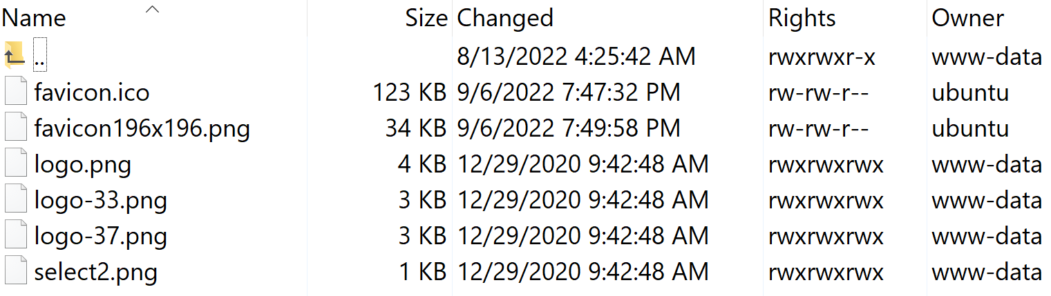
3. Change Favicon
sudo chmod -R 777 /var/www/espocrm.certifient.com/html/client/img
Upload favicon.ico, favicon196x196.png

Slide 15
4. Learn Domain Concepts
https://docs.espocrm.com/administration/portal/
Portal provides the ability to access specific CRM data and functions for your customers and partners.
Administrators can create multiple portals.
Each portal can have its own settings, dashboard, user list, access control settings.

Slide 16
5. Implement a Small Feature
https://docs.espocrm.com/administration/emails/

Slide 17

Thank You & See You Again

